Slide 1


Water Week 2021
National Stormwater Priorities
Recommendations from
Water Environment Federation
&
National Municipal Stormwater Alliance
April 2021
Meeting with:
John Smith
Jsmith@emailaddress.com
555-555-5555
Notes:
For the last several years a coalition of national water associations have joined together to host Water Week in Washington, DC, and around the country each spring.
This year it’s a virtual event due to the coronavirus crisis, but all the members of the water associations are still participating and doing congressional outreach to inform Congress about the immediate and long-term policy priorities for the water sector.

Slide 2

Meeting Agenda
Introductions
  Names of meeting participants
  Names of meeting participants
Update from (Name of town, utility, state, organization)
Priorities for the Water Sector
WATER WEEK 2021
APRIL 2021

Slide 3
Update from the ______
Include a couple bullet point items about the status of things back home, such as specific stormwater infrastructure projects needed or underway, or an update on the amazing work the employees are doing to protect the community, or any other challenges your organization is facing.
Feel free to add photos on this slide or create another slide.
WATER WEEK 2021
APRIL 2021

Slide 4
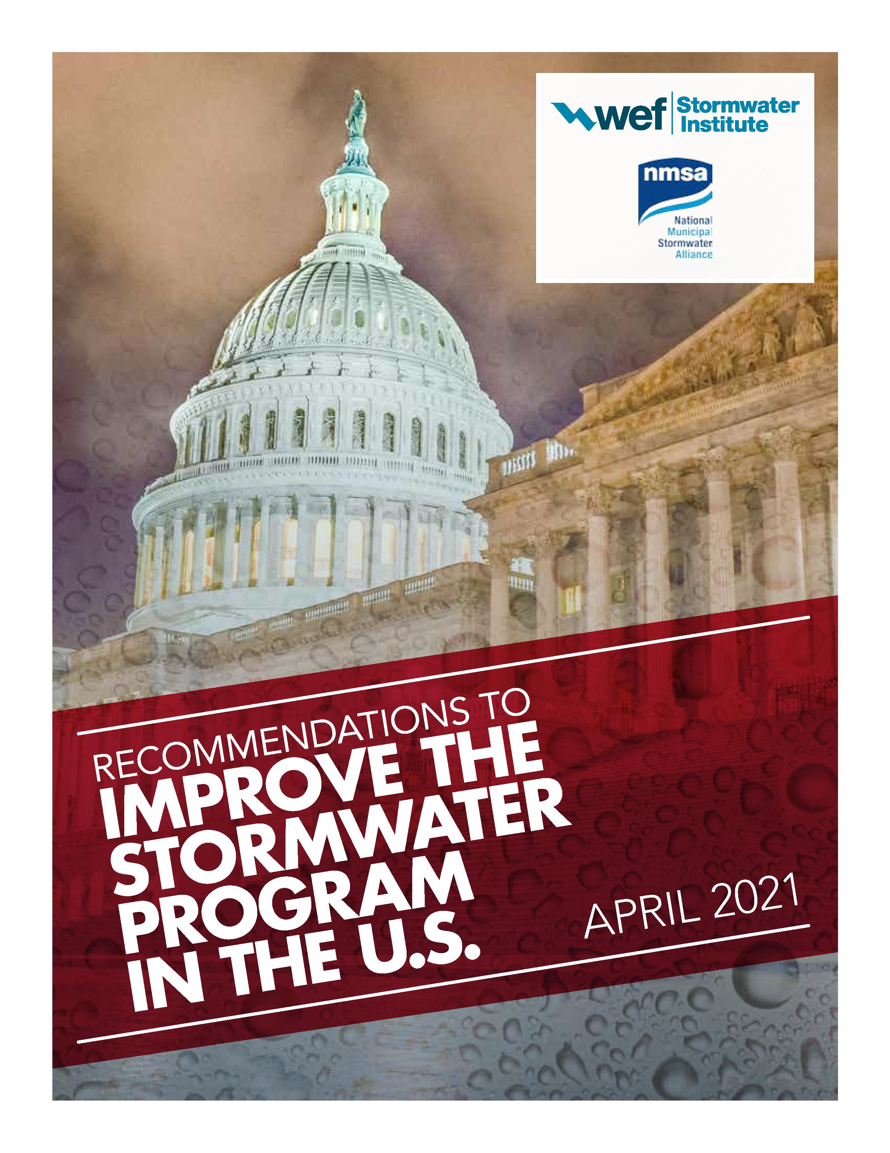
Four Core Recommendations
Recommendations Available at:
http://bit.ly/swi-2021
SW Infrastructure Funding Tools
Stormwater Treatment System Verification Program Funding
Local Flooding Product and Reference Development Funding
Promote Comprehensive Source Control for Stormwater Pollution
WATER WEEK 2021
APRIL 2021

Slide 5
There are massive national need for stormwater infrastructure funding.
  WEF’s 2020 MS4 National Needs Survey found a stormwater infrastructure funding needs gap of $8.5 billion annually.
  In March 2021, ASCE released their first-ever Stormwater Infrastructure Report Card and gave stormwater infrastructure a D Grade.
  Even more frequent and intense rain events are expected, according to the 2014 National Climate Assessment Report.
WATER WEEK 2021
APRIL 2021

Slide 6
Stormwater Infrastructure Funding MUST be included in the Infrastructure Package!
Funding MUST be as Grants or Forgivable Loans.
  Ratepayers and utilities cannot afford more loans.
  70% of MS4 communities lack a stormwater utility or way to repay a loan.
  Currently, federally-subsidized water infrastructure funding provides less than 5% of all local water infrastructure funding.
  It is estimated that nationally only 1.5 to 3 percent of the Clean Water SRF’s Green Project Reserve goes towards stormwater, but in many states zero percent goes towards stormwater.
WATER WEEK 2021
APRIL 2021

Slide 7
Four Core Recommendations
Recommendations Available at:
http://bit.ly/swi-2021
SW Infrastructure Funding Tools
Request: Establish dedicated stormwater funding for the construction, rehabilitation, and operation and maintenance of stormwater infrastructure. In addition, establish a technical assistance grant program (at regional or federal level) to assist communities and utilities with the creation of sustainable funding sources for stormwater infrastructure.
WATER WEEK 2021
APRIL 2021

Slide 8
Four Core Recommendations
Recommendations Available at:
http://bit.ly/swi-2021
2) Stormwater Treatment System Verification Program Funding
Request: Create up to 5 national centers of excellence and grant programs to drive research, planning and implementation of stormwater infrastructure as well as facilitate coordination between municipal stormwater permittees across all centers.
WATER WEEK 2021
APRIL 2021

Slide 9
Four Core Recommendations
Recommendations Available at:
http://bit.ly/swi-2021
3) Local Flooding Product and Reference Development Funding
Request: Provide funding to federal agencies to develop and maintain monitoring programs and technical products to enable local and state agencies to address current and projected local flooding challenges.
WATER WEEK 2021
APRIL 2021

Slide 10
Four Core Recommendations
Recommendations Available at:
http://bit.ly/swi-2021
4) Promote Comprehensive Source Control for Stormwater Pollution
Request: Direct the US EPA to establish a permanent program within the Office of Wastewater Management, and provide funding to be dedicated to developing pollutant source control for stormwater.
WATER WEEK 2021
APRIL 2021

Slide 11
2021 Infrastructure Package
Key Stormwater Infrastructure Programs to include in the Infrastructure Package:
Clean Water SRF – Forgivable Loans!
WIFIA
EPA Sewer Overflow & Stormwater Reuse Municipal Grants
Stormwater Infrastructure Technology Grants (Sect. 217, Senate Drinking Water & Wastewater Infrastructure Act of 2021, S. 914)
Watershed Pilot Projects (Sect. 3, House Water Quality Protection & Jobs Creation Act of 2021, H.R. 1915)
New Resiliency Grant Programs
WATER WEEK 2021
APRIL 2021

Slide 12
Additional Resources
Please contact _____ at (email address) if you would like a stormwater facility tour or a meet & greet with local stormwater professionals.
If you need additional info about the Recommendations, please contact:
  Steve Dye (WEF), sdye@wef.org
  Seth Brown (NMSA), seth.brown@nationalstormwateralliance.org
For additional info and materials, please visit:
  2021 Recommendations Document: http://bit.ly/swi-2021
  https://wefstormwaterinstitute.org
  https://nationalstormwateralliance.org
WATER WEEK 2021
APRIL 2021

